Slide 1
2heads
Tic-tac-toe v2.0

Slide 2
2heads - Tic-tac-toe v2.0
Objectives

Slide 3
2heads - Tic-tac-toe v2.0
Objectives
• Implement simple AI functionality
• Perform some major refactoring

Slide 4
2heads - Tic-tac-toe v2.0
Let’s play

Slide 5
2heads - Tic-tac-toe v2.0
Refactoring

Slide 6
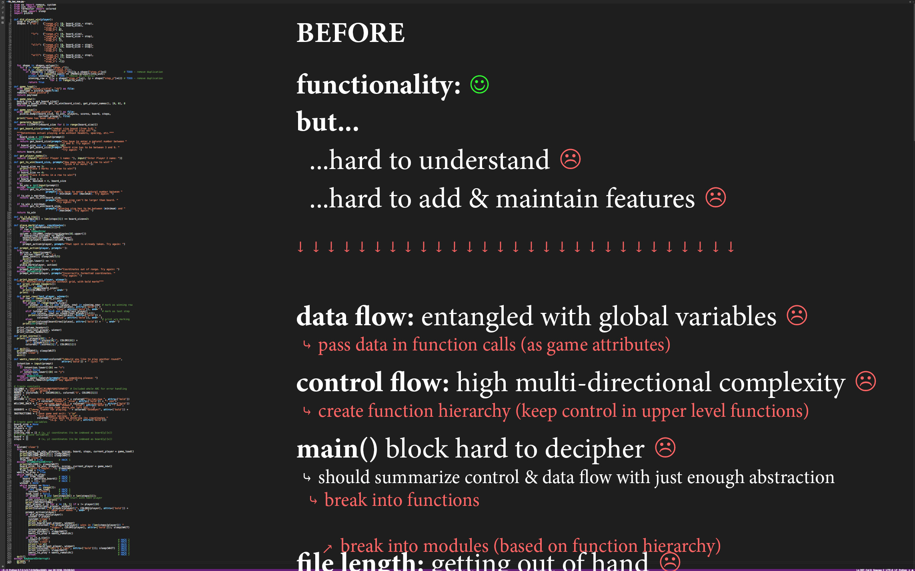

Slide 7
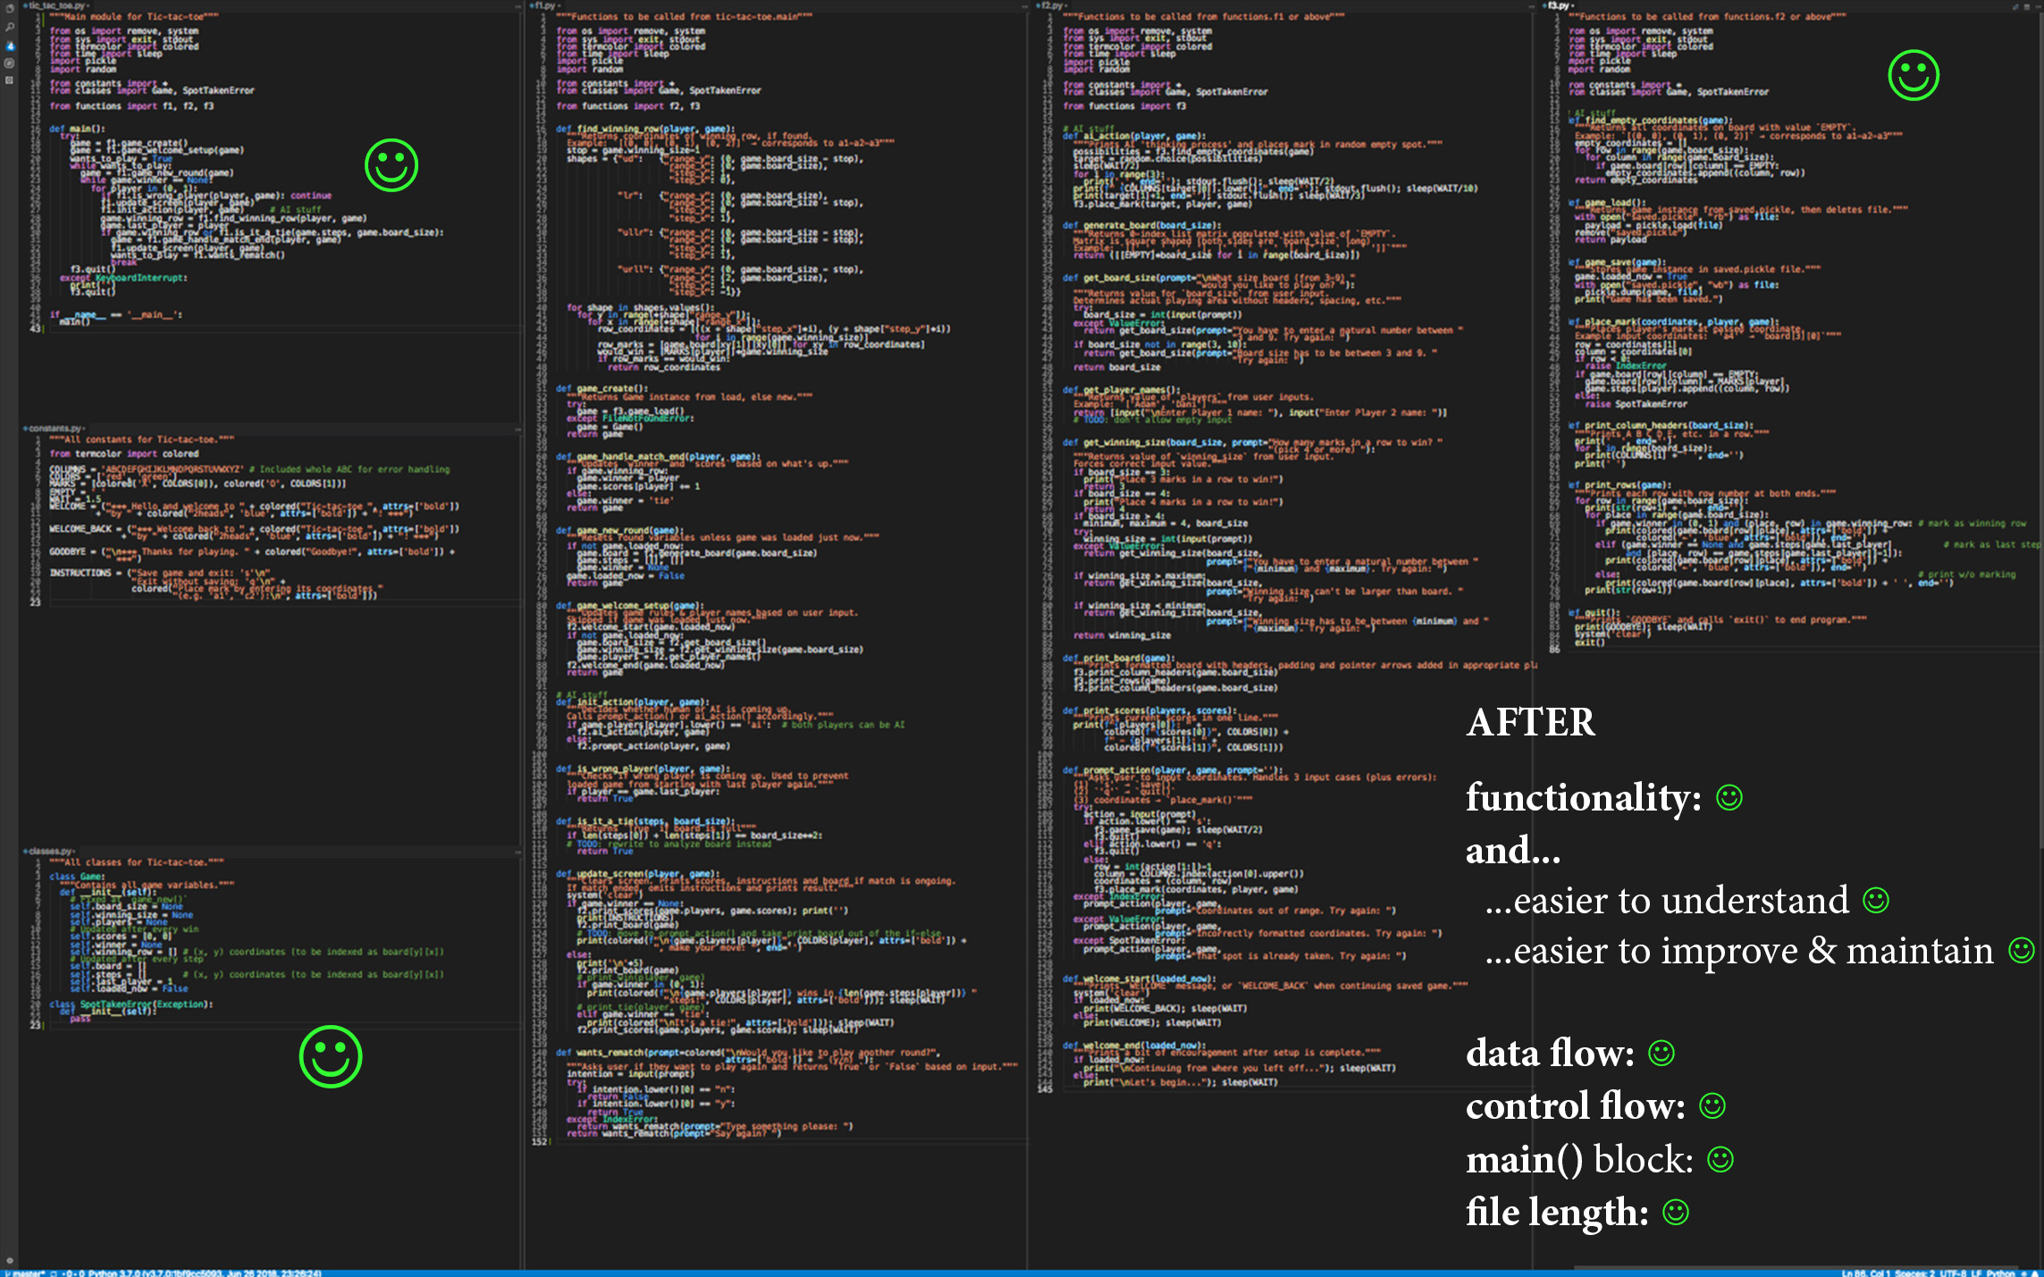

Slide 8
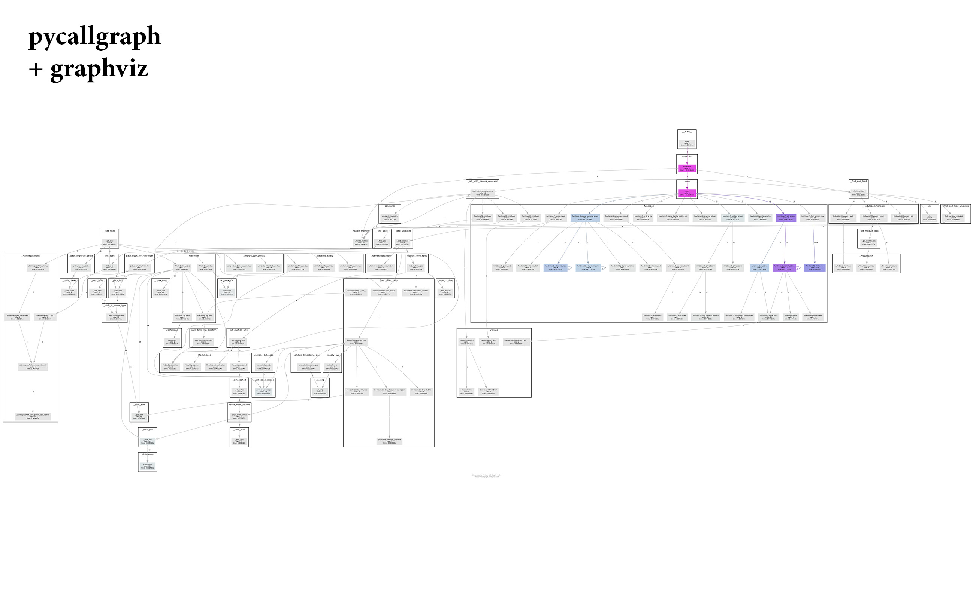

Slide 9
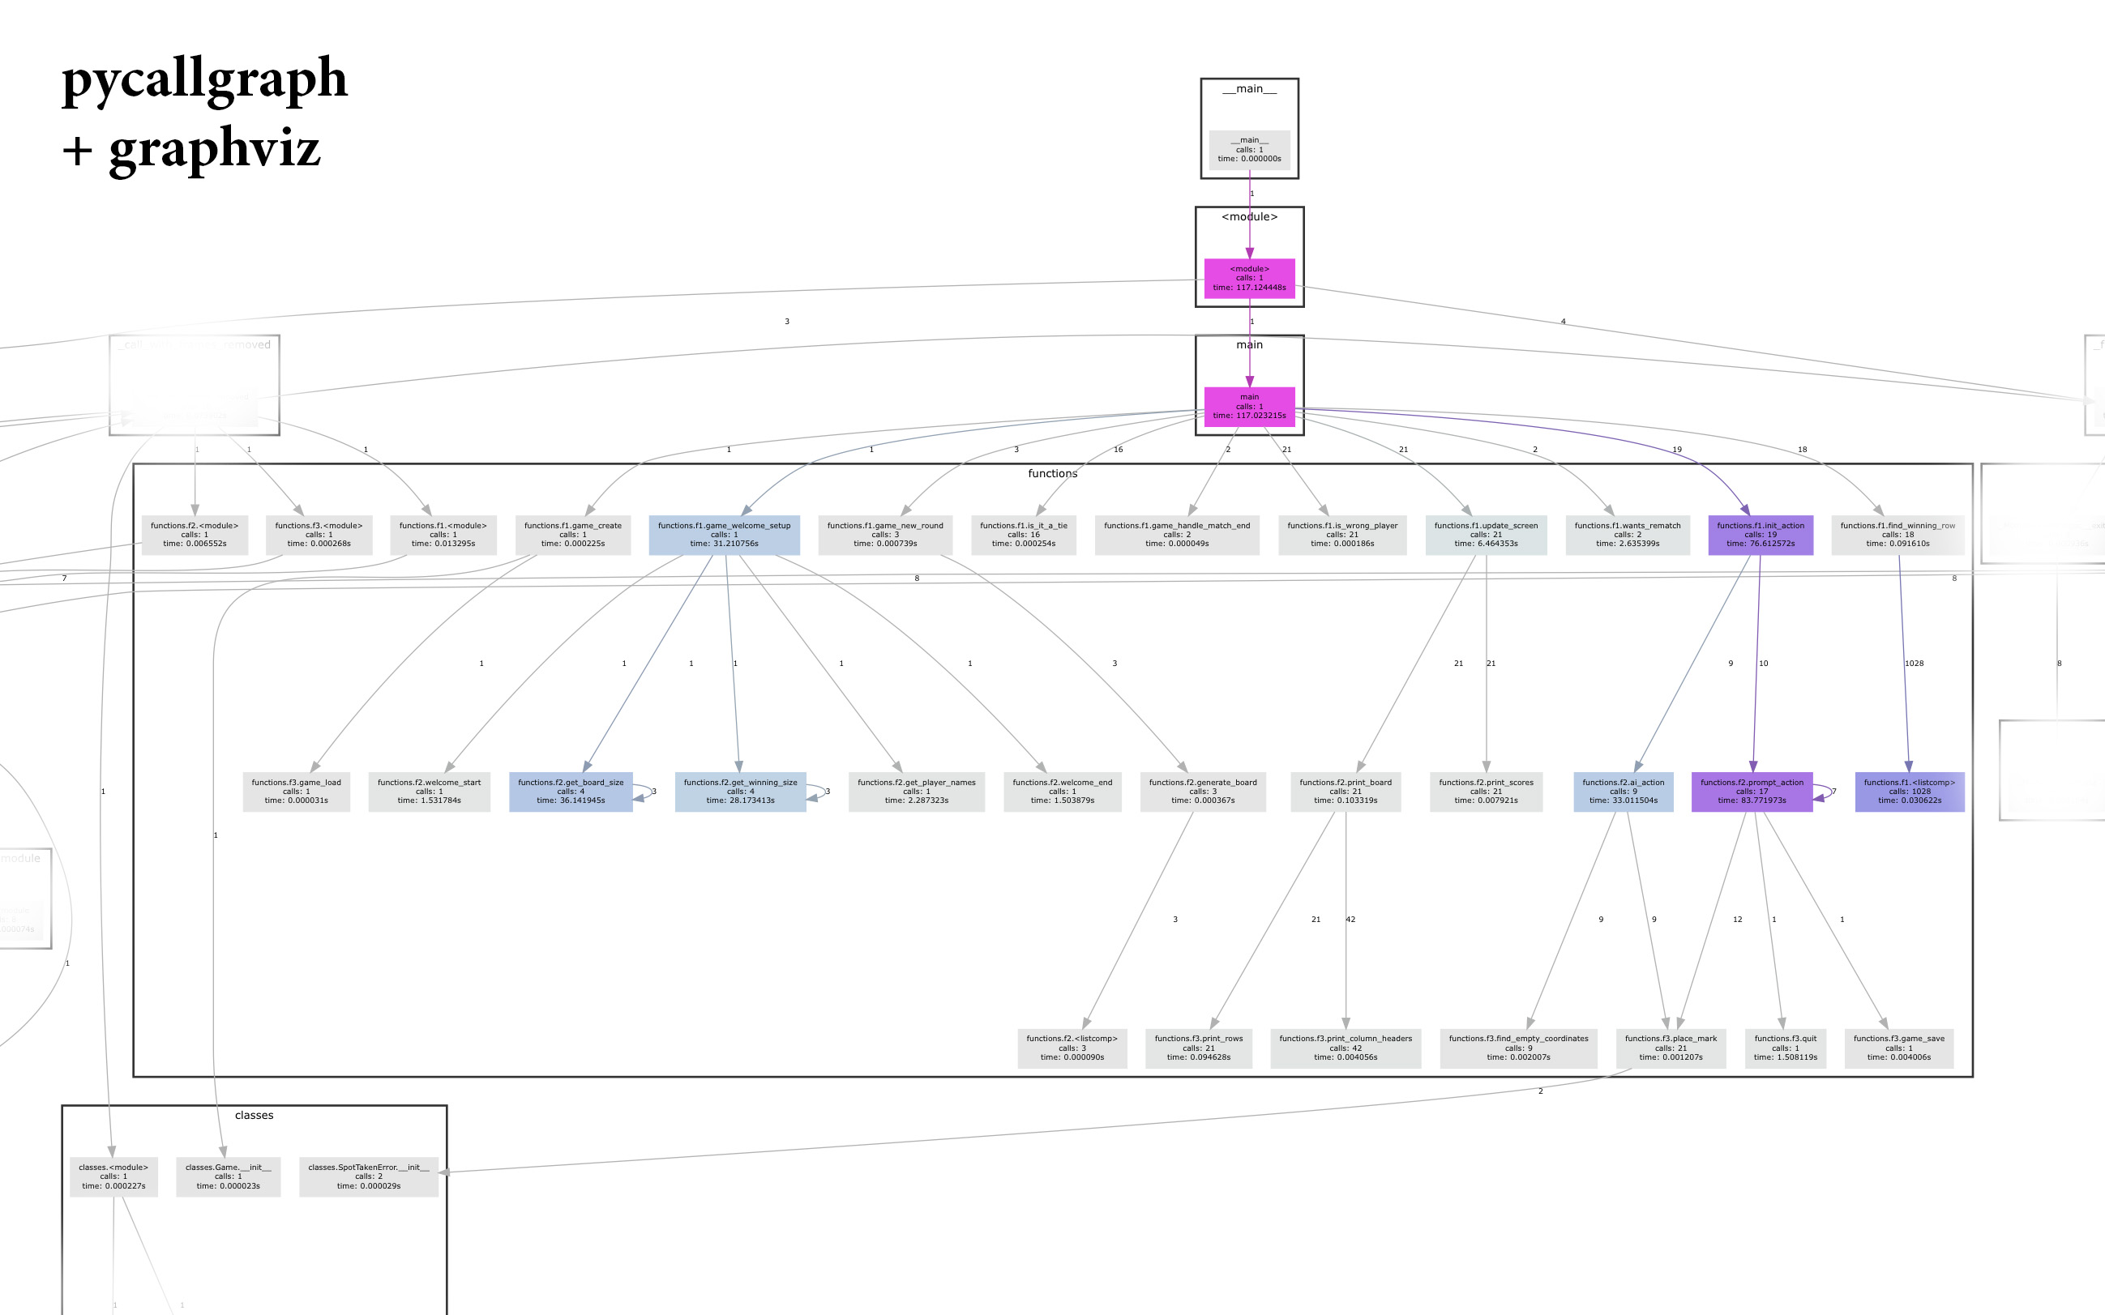

Slide 10
2heads - Tic-tac-toe v2.0
AI

Slide 11
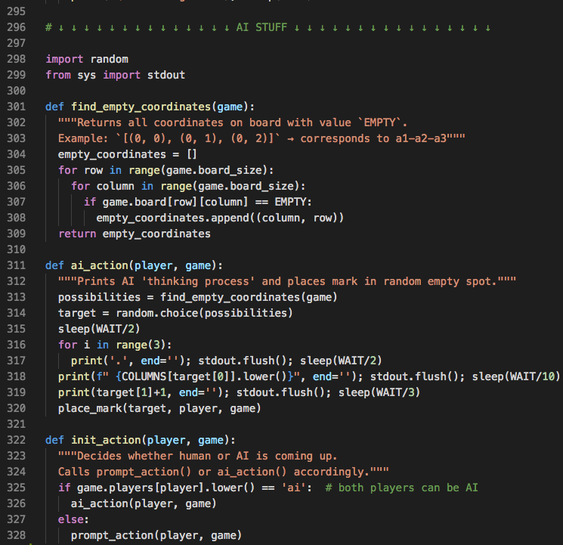

Slide 12
2heads - Tic-tac-toe v2.0
Let’s play more

Slide 13
2heads - Tic-tac-toe v2.0
Future plans

Slide 14
2heads - Tic-tac-toe v2.0
Future plans
• implement smarter AI • add convenience features

Slide 15
2heads - Tic-tac-toe v2.0
repo: http://tiny.cc/ttt2h

Slide 16
2heads - Tic-tac-toe v2.0
Thanks :)

